Slide 1
Deep Dive Project
Group 34
Chicago Type of Crime
Vir Sikand,
Elen Chatikyan,
Adam Schmitt,
Mohammed Shoaib Abbas
CS 547 / IE 534
Group 34

Slide 2
Chicago Type of Crime Project
Introduction
Motivation & Impact
Crime is a significant challenge faced by urban areas, including Chicago, where various neighborhoods experience different types and frequencies of criminal activity.
The goal of the project is to develop a predictive model to forecast and mitigate crime in Chicago.
Societal Contributions
Increase police presence in high-risk areas.
Alert citizens during historical crime spikes.
Allocate resources to education and community programs.
Aid urban planning for safer neighborhoods.
CS 547 / IE 534
Group 34
Vir Sikand, Elen Chatikyan, Adam Schmitt, Mohammed Shoaib Abbas
Notes:
Speaker -
crime prediction can help not just in prevention but also in promoting informed decision-making for residents and businesses
the potential societal impact, from improving safety to fostering economic growth in safer areas

Slide 3
Problem Statement
Introduction
Which factors, if any, can help us best predict when and where crime will occur in Chicago?
Can we accurately classify these crime predictions?
Violent crimes are more critical to predict and prevent
CS 547 / IE 534
Group 34
Vir Sikand, Elen Chatikyan, Adam Schmitt, Mohammed Shoaib Abbas

Slide 4
Overview
Data Extraction
Data Exploration
Deep Learning
Feature Importance
Conclusion
CS 547 / IE 534
Group 34
Vir Sikand, Elen Chatikyan, Adam Schmitt, Mohammed Shoaib Abbas

Slide 5
Data Extraction
CS 547 / IE 534
Group 34
Adam Schmitt

Slide 6
Data Gathering
Data Extraction
Supporting data was pulled from multiple sources:
Chicago Data Portal
Reported crime incidents within Chicago from 2001 to present
Socioeconomic dataset for each Chicago community area (CCA)
National Oceanic and Atmospheric Administration (NOAA)
Daily weather data for chicago
Kaggle
U.S. Holiday dataset
CS 547 / IE 534
Group 34
Adam Schmitt

Slide 7
Crime Data Extraction
Data Extraction
450,000 Incidents
Handle NaNs
Group location descriptions so they can be handled as Booleans
Pickle data for quicker loading
CS 547 / IE 534
Group 34
Adam Schmitt

Slide 8
Merging Holiday, Weather, and Economic data
Data Extraction
For each crime report, append the following data:
Weather on the day of the crime
Temperature
Precipitation
Snow
Socioeconomic indicators for the crime area
Per Capita Income
Holiday information
Holiday (Y/N)
Weekend (Y/N)
CS 547 / IE 534
Group 34
Adam Schmitt

Slide 9
Data Exploration
CS 547 / IE 534
Group 34
Elen Chatikyan

Slide 10
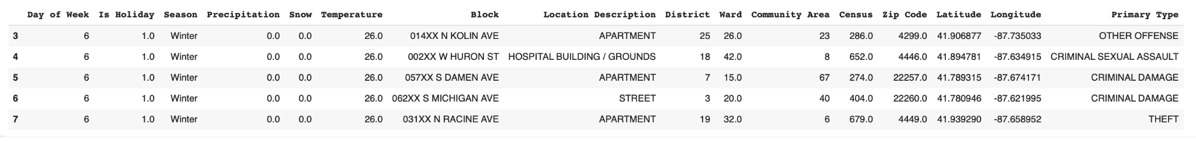
Data Exploration
Data Exploration
District
Ward
Community Area
Census
Zip Code
Latitude
Longitude
Goal for this step was to understand the structure, distribution, and characteristics of the dataset and identify potential issues such as missing, imbalanced, or sparse data.
After analyzing and cleaning the data we have we decided to work with the following columns for the training
Features
Day of Week
Is Holiday
Season
Precipitation
Snow
Temperature
Block
Location Description
Label
Primary Type
Sample data
CS 547 / IE 534
Group 34
Elen Chatikyan
Notes:
understanding the data ensures the model we build is robust and well-informed
used visualization and statistical tools to uncover patterns and biases

Slide 11
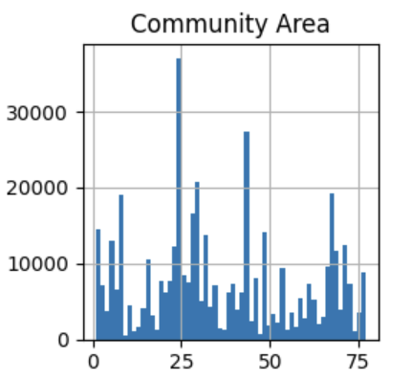
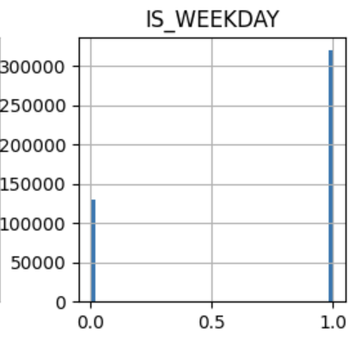
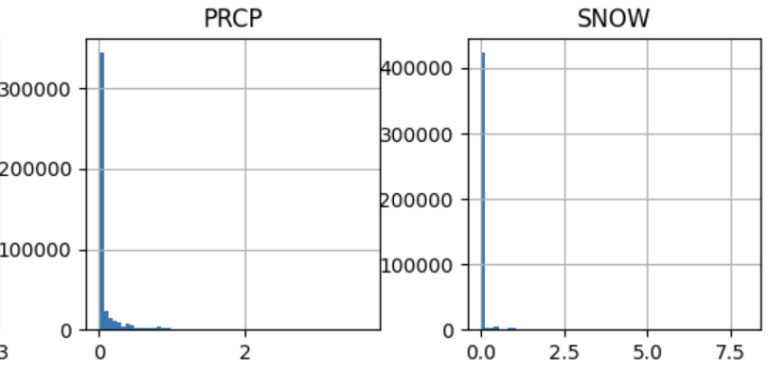
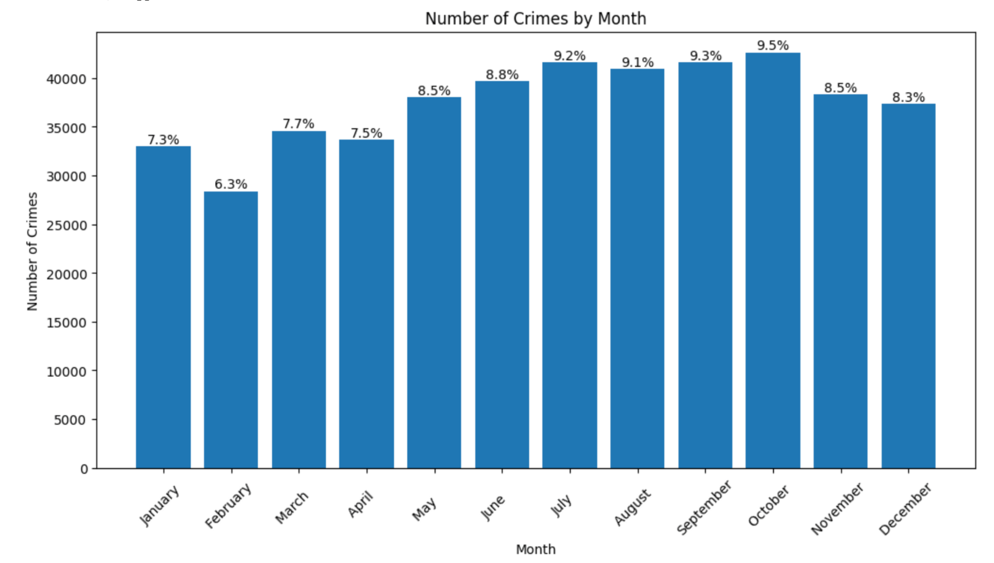
Observing the Class Distribution for the target label
Data Exploration
CS 547 / IE 534
Group 34
Elen Chatikyan
Notes:
Observing the Class Distribution for the target label
Examining the above bar chart, we see that the largest number of crimes are commited between May and November,
We also see that certain community areas have significantly higher counts of crimes. We should look into the characteristics of the crimes happening in these community areas. Perhaps the community area will prove to be one of the more important features when trying to predict crime.

Slide 12
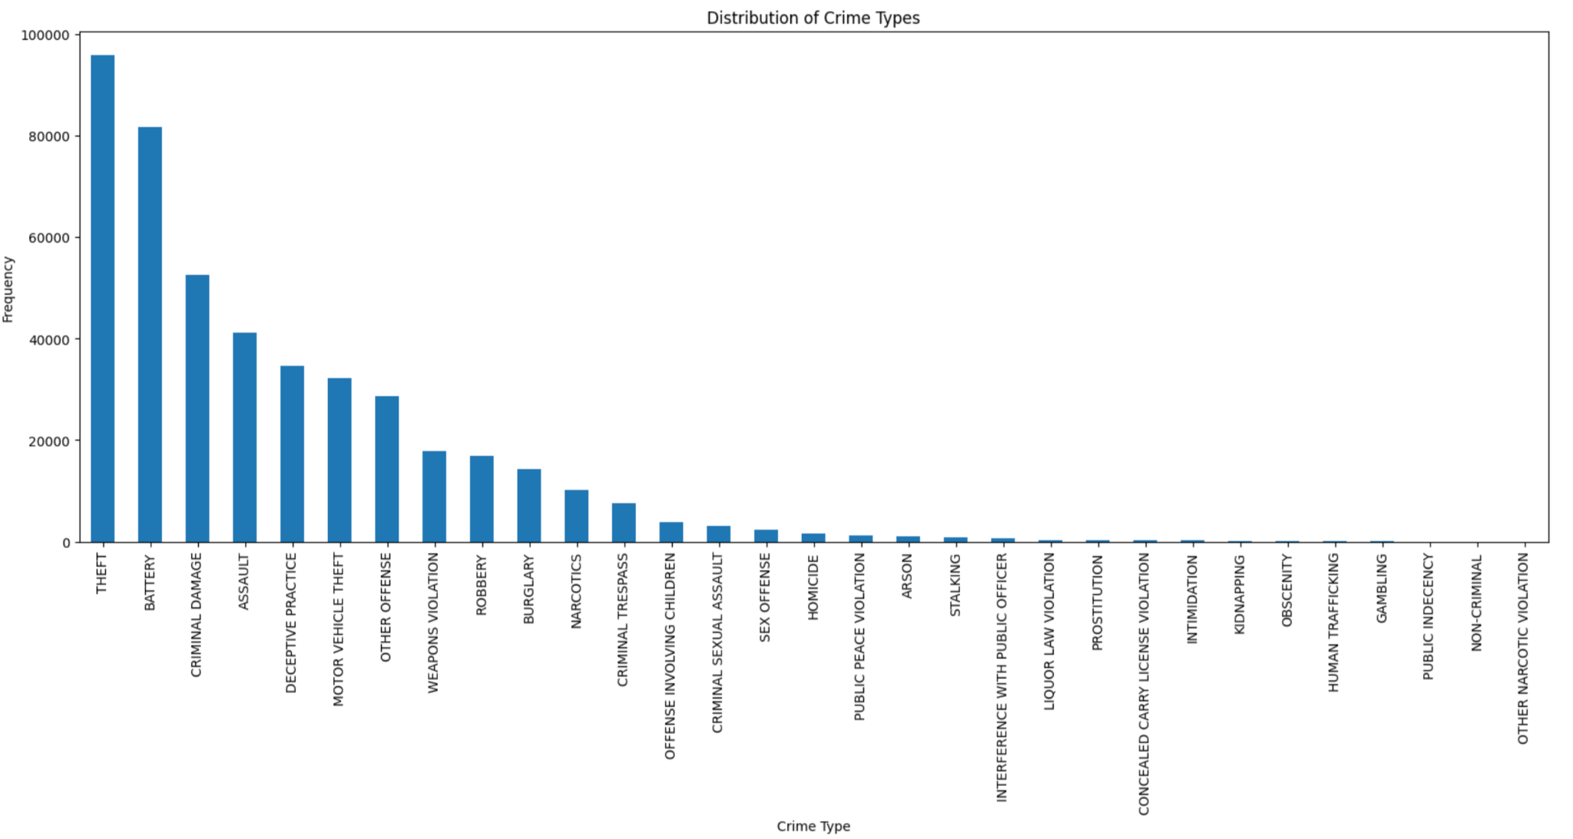
Observing the distribution of crime types
Data Exploration
CS 547 / IE 534
Group 34
Elen Chatikyan
Notes:
As we can see in the plot above, the dataset exhibits significant class imbalance, with a few classes such as **THEFT**, **BATTERY**, and **CRIMINAL DAMAGE** dominating the majority of the data, while rare crime types like **Public Indecency**, **Human Trafficking**, and **Gambling** have very few instances. This imbalance might lead to biased model predictions, where the model may perform well on the majority classes but fail to accurately identify rare events.
We should apply appropriate evaluation metrics to ensure that minority classes are adequately represented and predicted.
With logistic regression we got very low accuracy which suggests that the model struggles at predicting the correct crime type, possible reasons might be
- class imbalance
- wrong model(Logistic Regression)
- data preprocessing pipeline or the columns that were used for prediction

Slide 13
Deep Learning
CS 547 / IE 534
Group 34
Vir Sikand

Slide 14
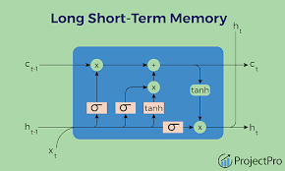
Deep Learning
Deep Learning
Approach was to use an LSTM Model
LSTM is a type of Long Short Term Memory RNN unit
Helps with capturing long term dependencies within code, and has a forget gate:
Decides what information to remove from the cell state
Helps prevent information overload by selectively discarding irrelevant past data
Controls what new information is stored in the cell state.
Works with the forget gate to maintain a balance between past and new information.
Determines what part of the cell state contributes to the output.
Ensures only relevant features influence the next hidden state and output.
We used an 80% to 20% Training/Validation Data Split
We ranked features beforehand by importance using a random forest classifier and only used the top 4 for training the model: Longitude, Temperature, Latitude, Block
CS 547 / IE 534
Group 34
Vir Sikand

Slide 15
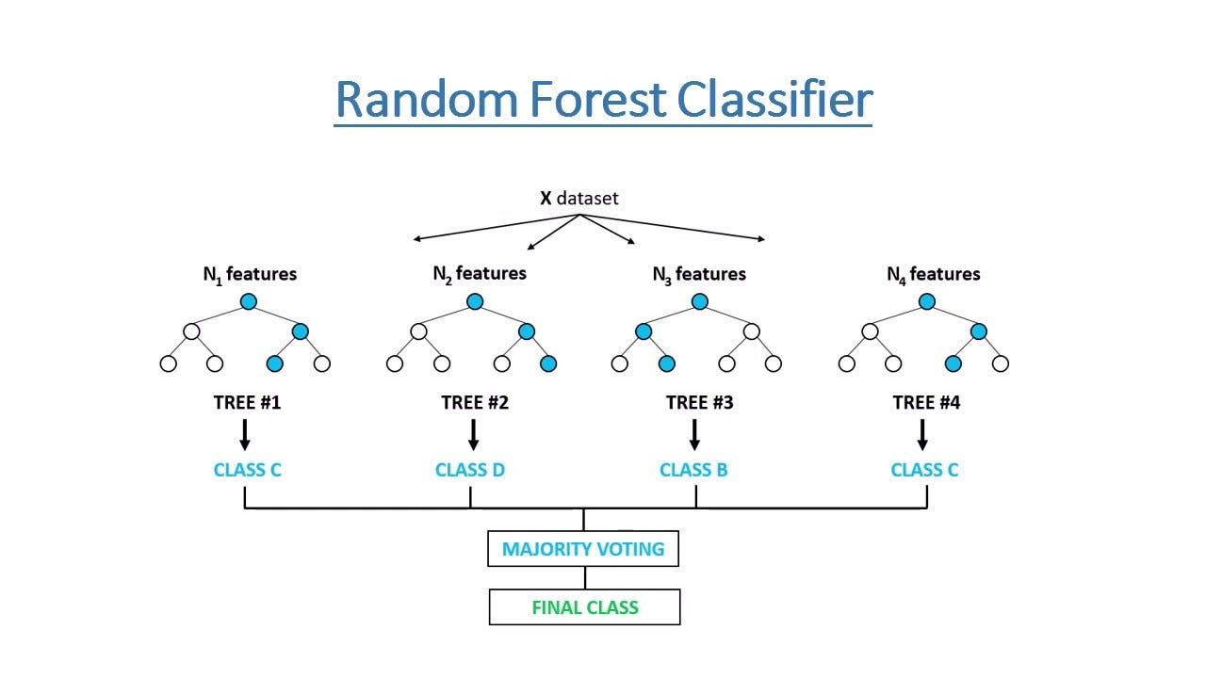
Performance
Deep Learning
Numbers:
Achieved final validation accuracy of 0.2474
Loss decreased from 2.5811 to 2.3282
Used 5 epochs to help try to reduce overfitting
Used Batch Size of 256
Analysis:
Crime data is categorical not sequential
LSTMs assume their is a dependency that lies between data points (like in text), which might not apply for certain categories.
There might be many features in the data at play with so many categories.
Other types of models may be better suited at handling these types of tasks with this sort of data.
CS 547 / IE 534
Group 34
Vir Sikand

Slide 16
Feature Importance
CS 547 / IE 534
Group 34
Mohammed Shoaib Abbas

Slide 17
Feature Importance
Feature Importance
Normalized Importance (Weight-Based)
Normalized Importance is derived from the absolute weights of features in a linear model (e.g., Logistic Regression)
Simpler Approach: No data permutation or direct measurement of model performance degradation is involved.
Model-dependent and only valid for models that provide interpretable weights.
Does not measure the true impact of a feature on model performance
CS 547 / IE 534
Group 34
Mohammed Shoaib Abbas

Slide 18
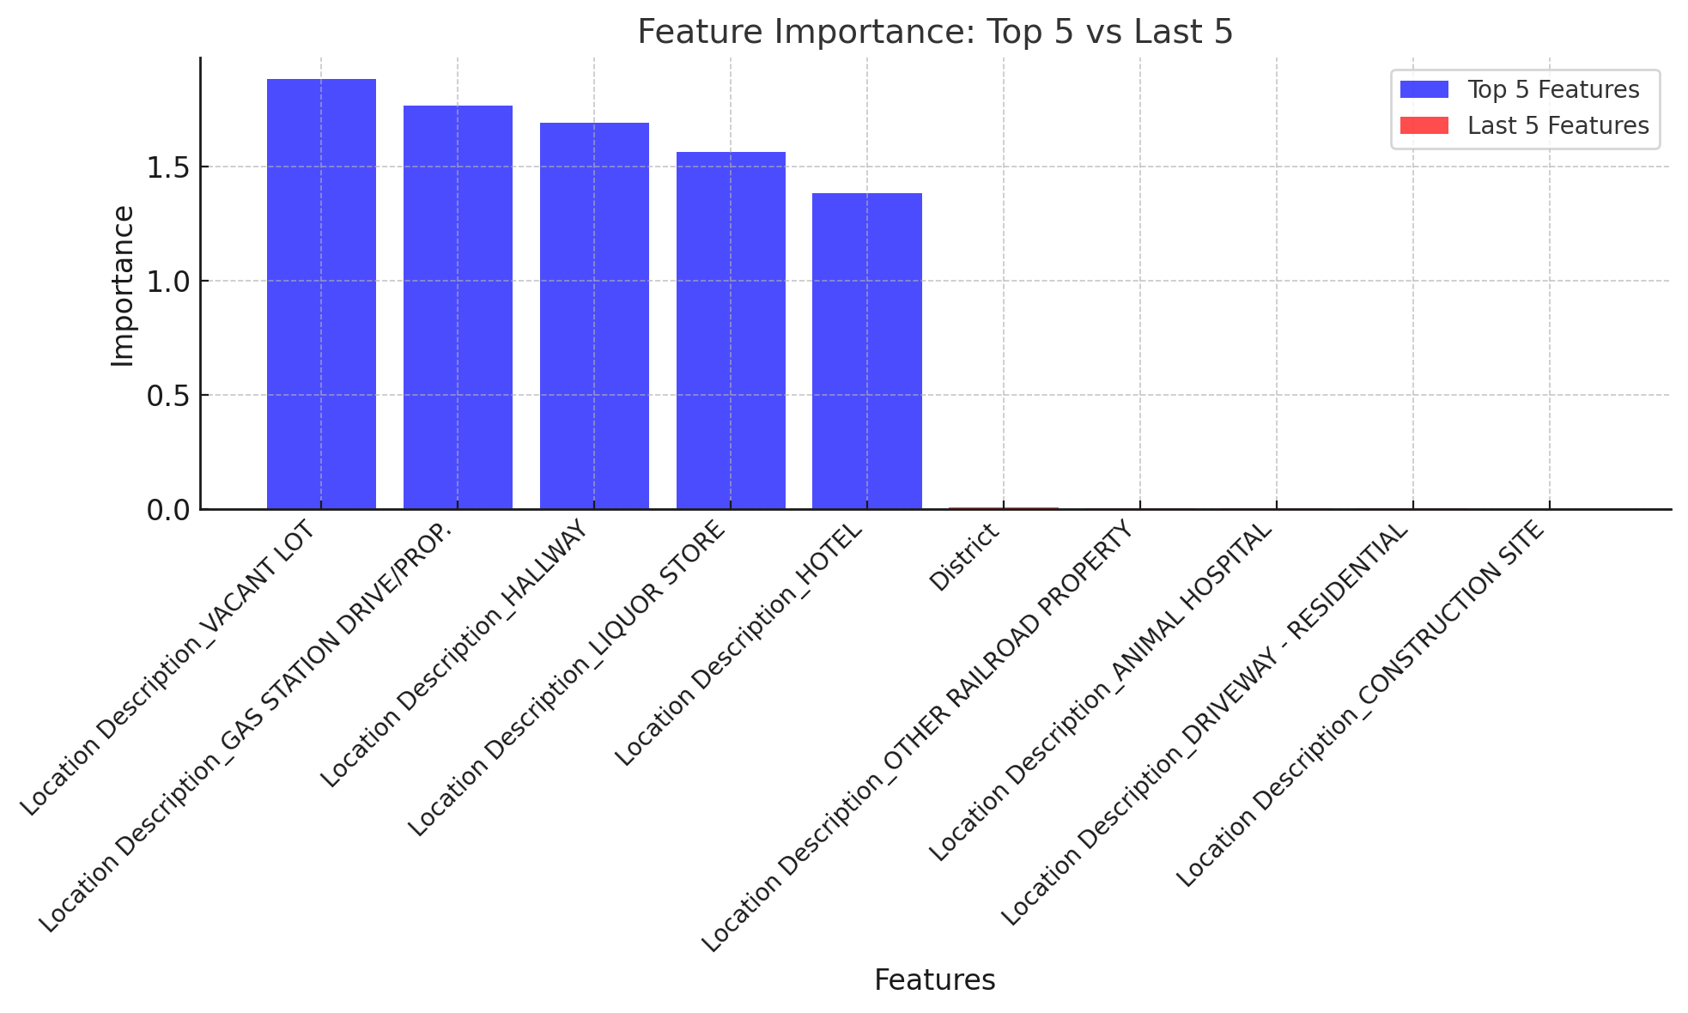
Feature Importance
Feature Importance
Mean Permutation Importance
How much the model relies on each feature for accurate predictions
Helps uncover critical features
Highlights irrelevant or misleading features.
CS 547 / IE 534
Group 34
Mohammed Shoaib Abbas

Slide 19
Conclusion
More than half of the features had a Shap value of zero.
Lots of noise in our data that was unrelated to crime
Many redundant features in our dataset
Latitude/Longitude closely related to Ward and Community Area
Neither LSTM nor Logistic Regression yielded accurate results
To continue analysis, we would try XGBoost or Random Forest Classifier next
Crime is a complex issue linked to many socioeconomic and political factors
More data containing poverty levels, hardship indices, and local political indicators would aid further analysis
CS 547 / IE 534
Group 34
Vir Sikand, Elen Chatikyan, Adam Schmitt, Mohammed Shoaib Abbas
Notes:
More Data wont be helpful
Too many features that are not helpful

Slide 20
Thank You
THANK YOU!
CS 547 / IE 534
Group 34
Vir Sikand, Elen Chatikyan, Adam Schmitt, Mohammed Shoaib Abbas

